Slide 1
The Microarchitecture Level
CHAPTER 4

Slide 2
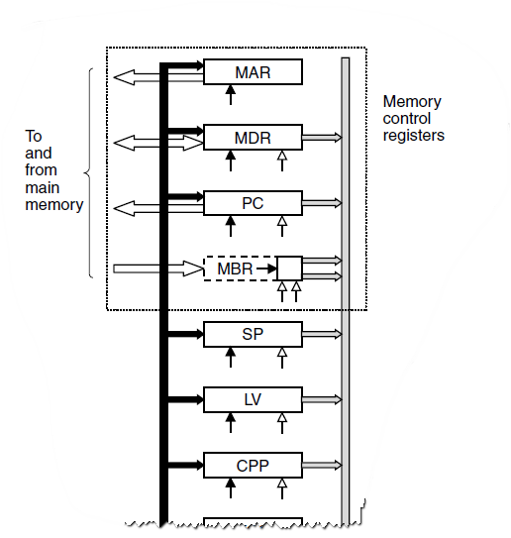
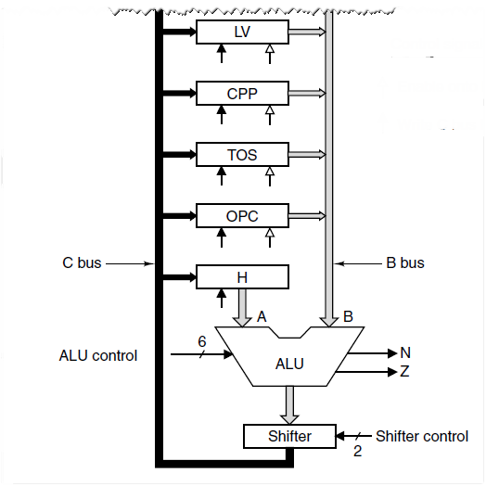
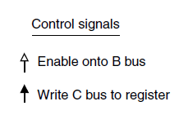
The Data Path (1)

Slide 3
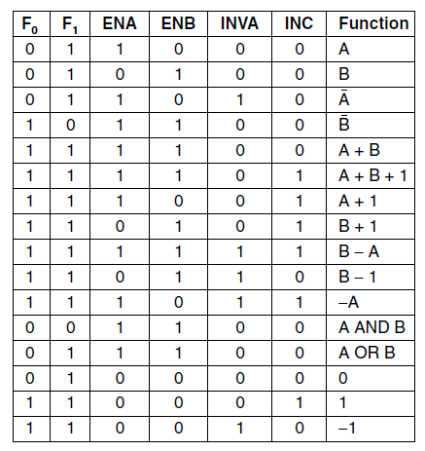
The Data Path (2)

Slide 4
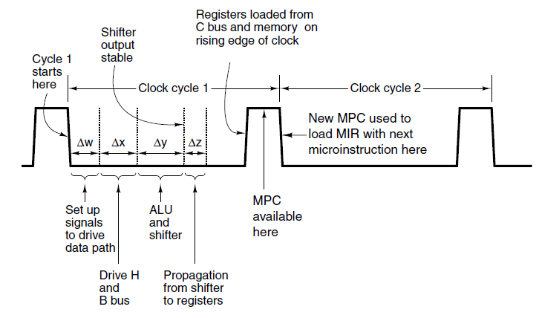
Data Path Timing (1)

Slide 5
Data Path Timing (2)
Activities of subcycles with subcycle length:
The control signals are set up (Δw)
The registers are loaded onto the B bus (Δx)
The ALU and shifter operate (Δy)
The results go along the C bus back to the registers (Δz)

Slide 6
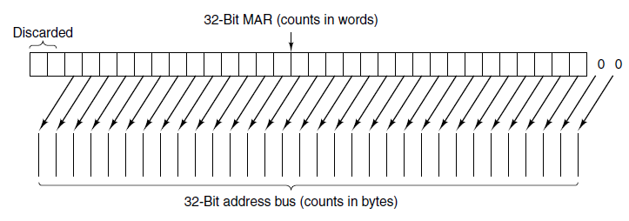
Memory Operation

Slide 7
Microinstructions (1)
Functional Signal Groups:
9 Signals to control writing data from C bus into registers.
9 Signals to enable registers onto B bus for ALU input.
8 Signals to control ALU and shifter functions.
2 Signals to indicate memory read/write via MAR/MDR.
1 Signal to indicate memory fetch via PC/MBR.

Slide 8
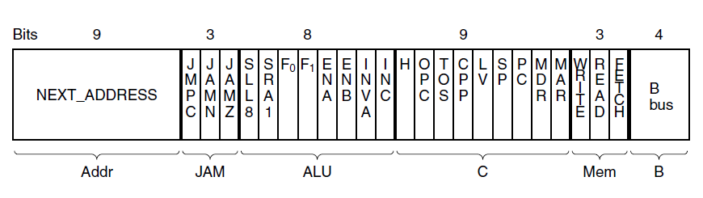
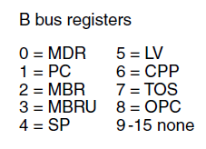
Microinstructions (2)
Figure 4-5. The microinstruction format for the Mic-1.

Slide 9
Microinstructions (3)
Groups of signals:
Addr – Contains address of potential next microinstruction.
JAM – Determines how te next microinstruction selected.
ALU – ALU and shifter functions.
C – Selects which registers written from C bus.
Mem – Memory functions.
B – Selects B bus source; encoded as shown.

Slide 10
Microinstruction Control: The Mic-1 (1)
The sequencer must produce two kinds of information each cycle:
The state of every control signal in the system
The address of the microinstruction that is to be executed next

Slide 11
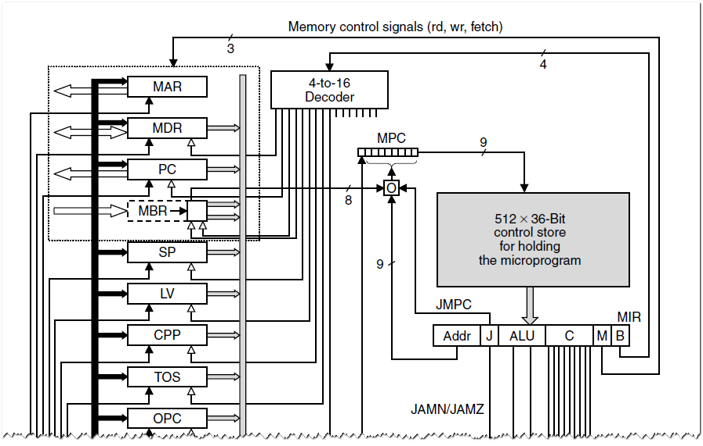
Microinstruction Control: The Mic-1 (2)

Slide 12
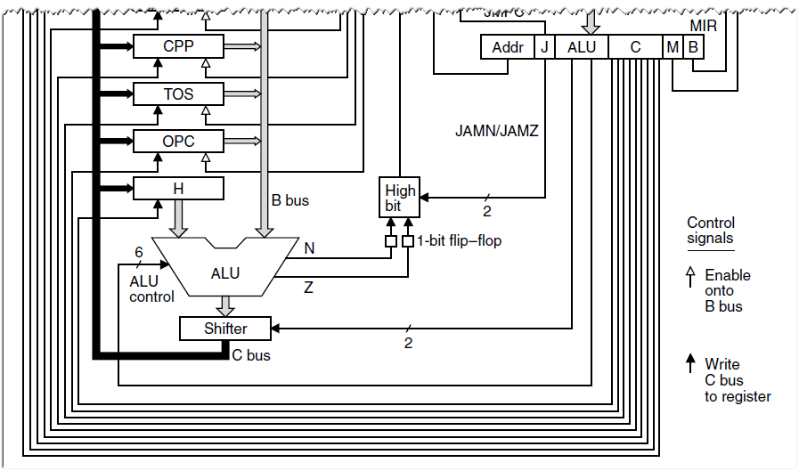
Microinstruction Control: The Mic-1 (3)

Slide 13
Microinstruction Control: The Mic-1 (4)
In all cases, MPC can take on only one of two possible values:
The NEXT ADDRESS
The NEXT ADDRESS with the high-order bit ORed with 1

Slide 14
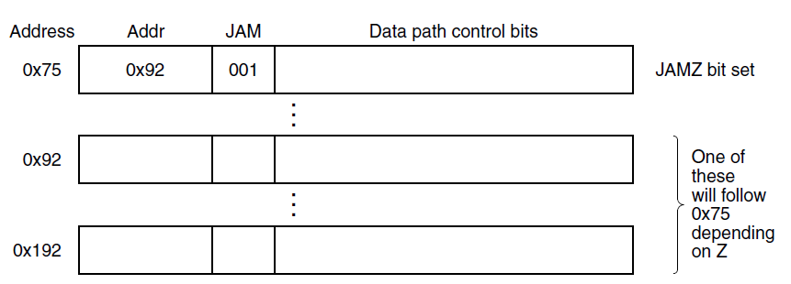
Microinstruction Control: The Mic-1 (5)

Slide 15
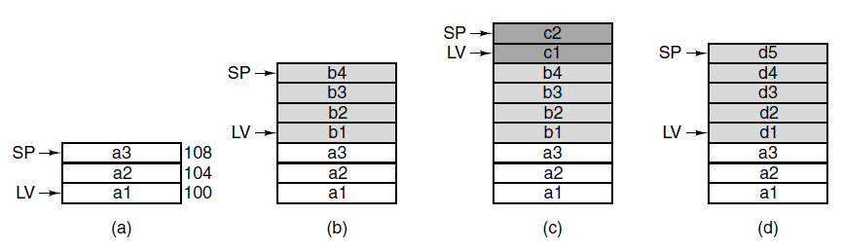
Stacks (1)

Slide 16
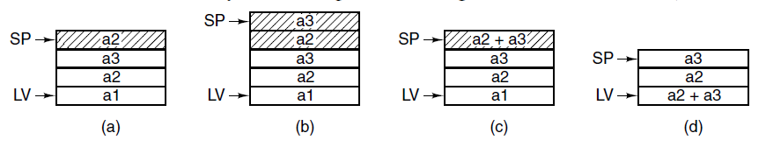
Stacks (2)

Slide 17
The IJVM Memory Model (1)
Defined areas of memory
The constant pool
The Local variable frame
The operand stack
The method area

Slide 18
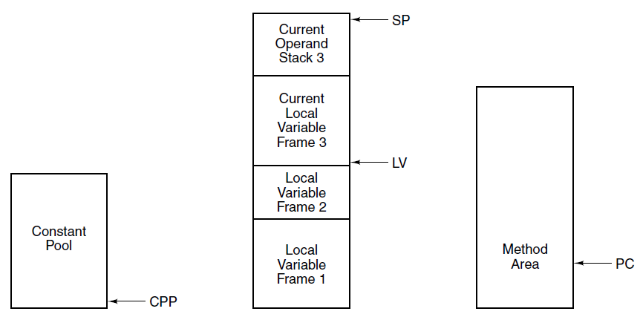
The IJVM Memory Model (2)
Figure 4-10. The various parts of the IJVM memory.

Slide 19
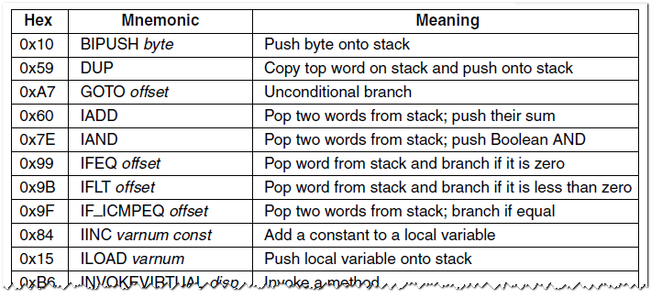
The IJVM Instruction Set (1)

Slide 20
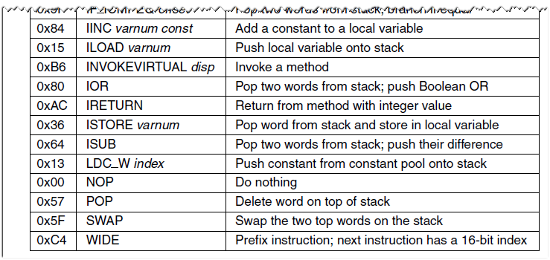
The IJVM Instruction Set (2)

Slide 21
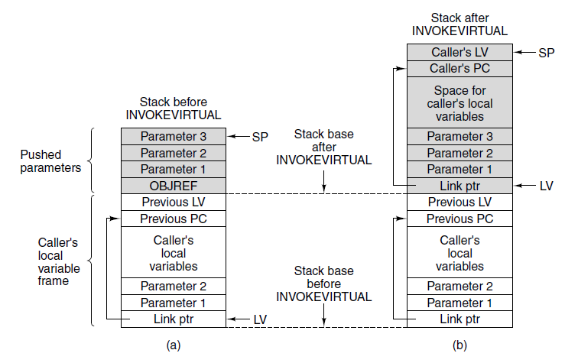
The IJVM Instruction Set (3)

Slide 22
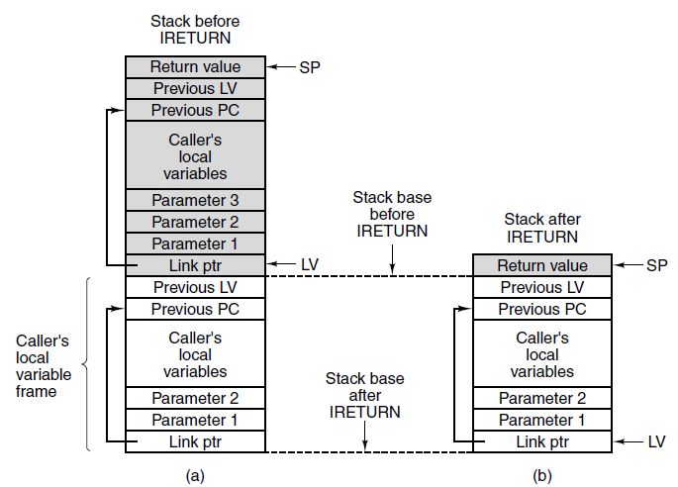
The IJVM Instruction Set (4)

Slide 23
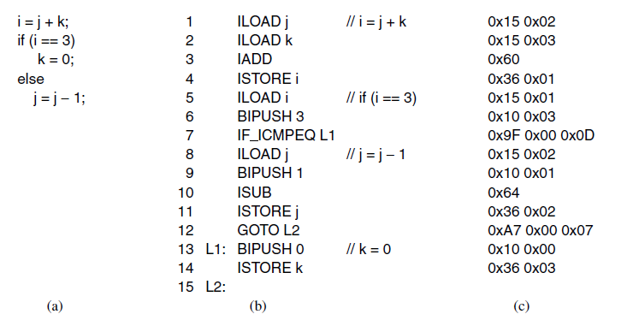
Compiling Java to IJVM (1)

Slide 24
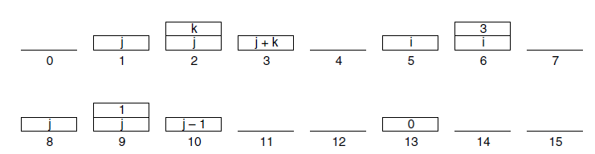
Compiling Java to IJVM (2)

Slide 25
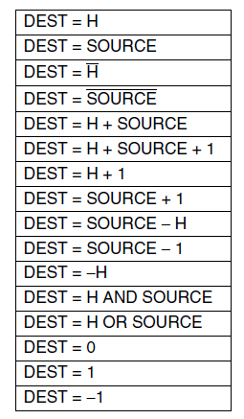
Microinstructions and Notation

Slide 26
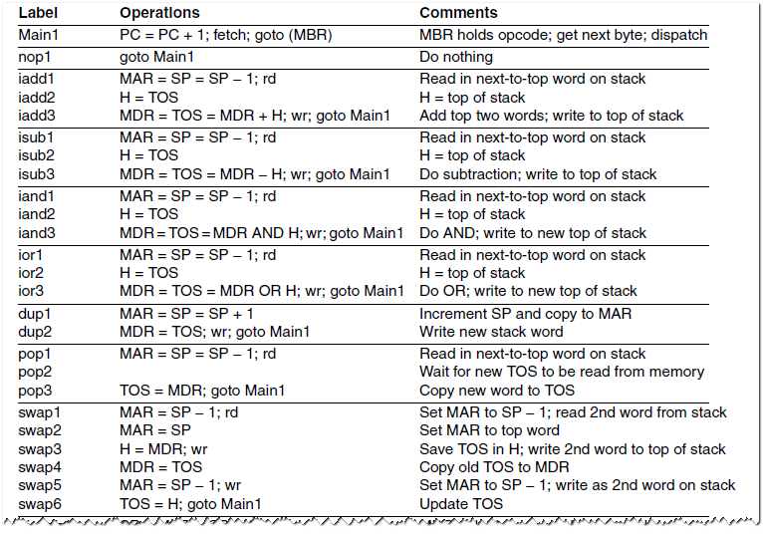
Implementation of IJVM Using the Mic-1

Slide 27
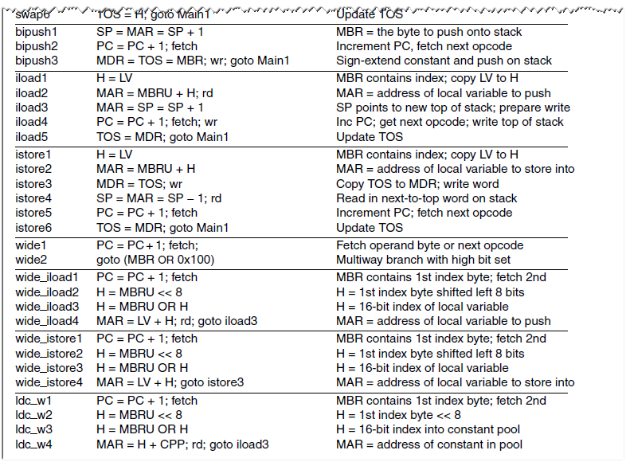
Implementation of IJVM Using the Mic-1

Slide 28
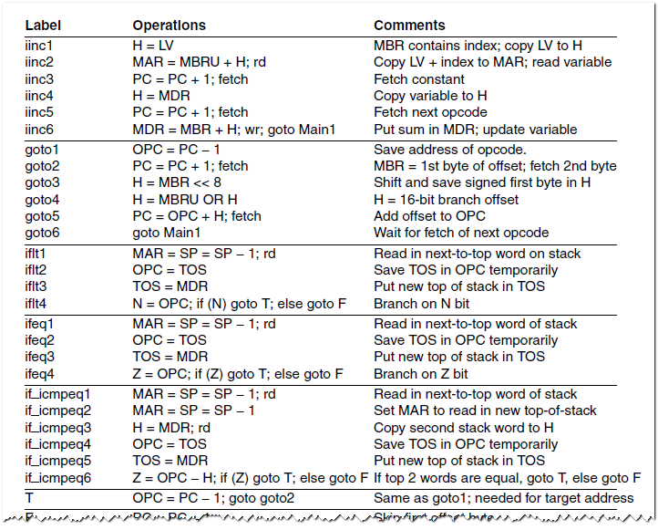
Implementation of IJVM Using the Mic-1

Slide 29
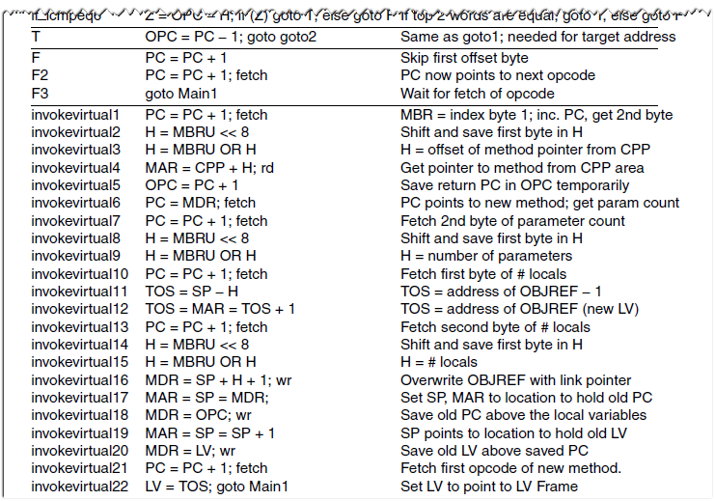
Implementation of IJVM Using the Mic-1

Slide 30
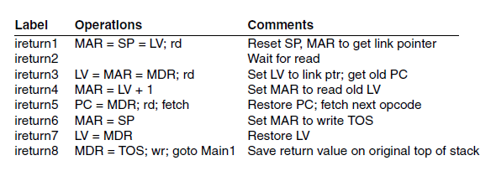
Implementation of IJVM Using the Mic-1

Slide 31
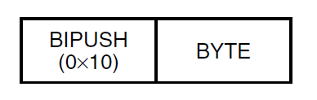
Implementation of IJVM Using the Mic-1 (2)

Slide 32
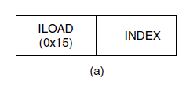
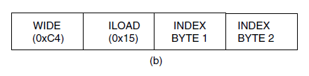
Implementation of IJVM Using the Mic-1 (3)

Slide 33
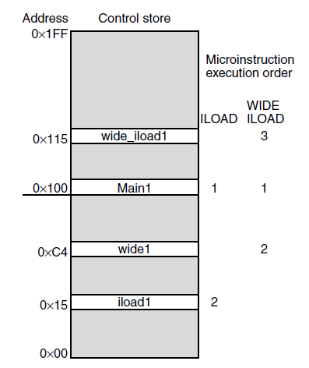
Implementation of IJVM Using the Mic-1 (4)

Slide 34

Implementation of IJVM Using the Mic-1 (5)

Slide 35
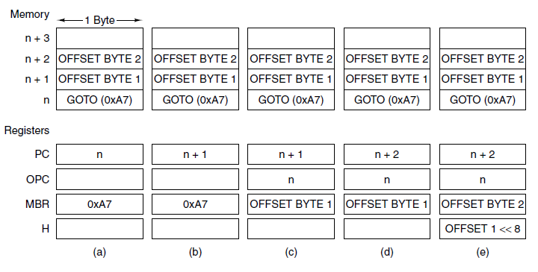
Implementation of IJVM Using the Mic-1 (6)
Figure 4-22. The situation at the start of various microinstructions. (a) Main1. (b) goto1. (c) goto2. (d) goto3. (e) goto4.

Slide 36
Speed versus Cost
Basic approaches for increasing the speed of execution:
Reduce # of clock cycles needed to execute an instruction
Simplify organization so that clock cycle can be shorter
Overlap execution of instructions

Slide 37
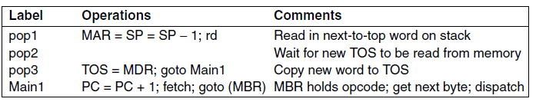
Merging Interpreter Loop with Microcode (1)

Slide 38
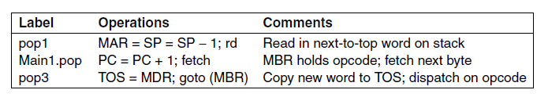
Merging Interpreter Loop with Microcode (2)

Slide 39
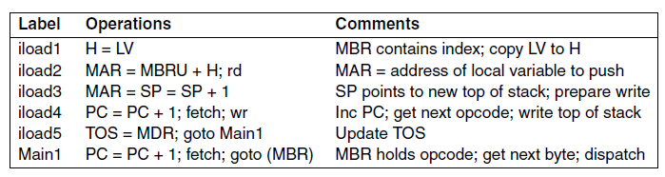
Three-Bus Architecture (1)

Slide 40
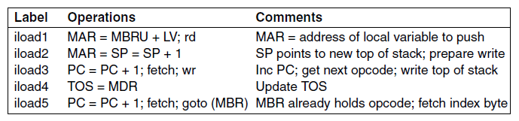
Three-Bus Architecture (2)

Slide 41
Instruction Fetch Unit (1)
For every instruction the following operations may occur:
PC passed through ALU and incremented.
PC used to fetch next byte in instruction stream.
Operands read from memory.
Operands written to memory.
The ALU does computation and results stored back.

Slide 42
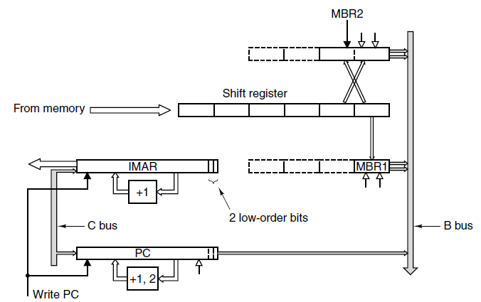

Instruction Fetch Unit (2)

Slide 43
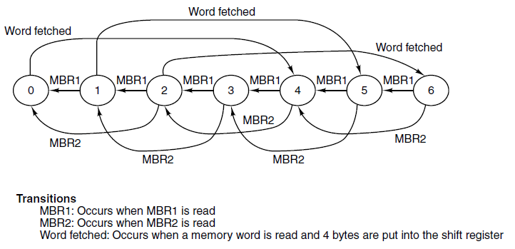
Instruction Fetch Unit (3)

Slide 44
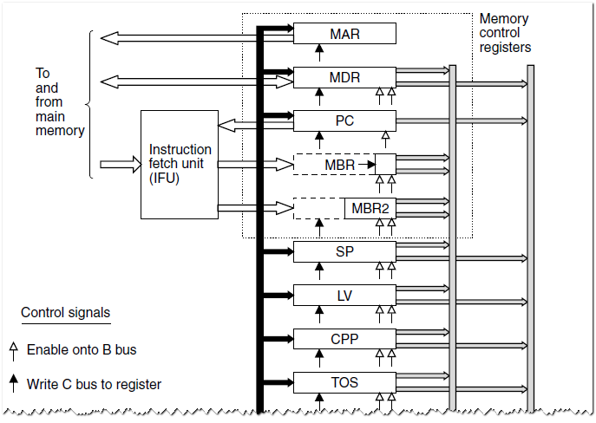
Design with Prefetching: The Mic-2 (1)

Slide 45
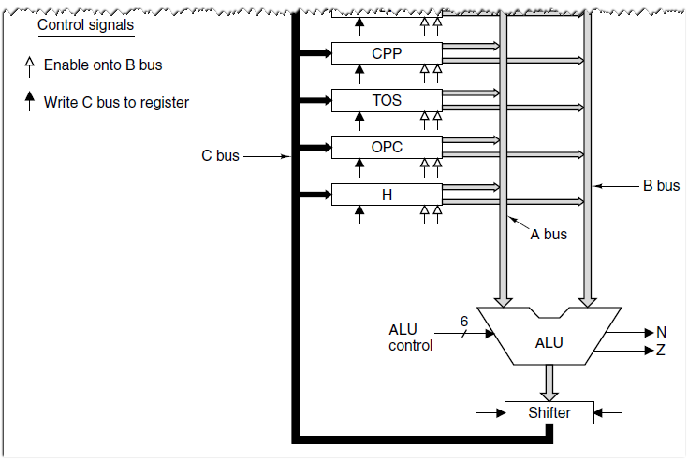
Design with Prefetching: The Mic-2 (2)

Slide 46
Pipelined Design: The Mic-3 (1)
Major components to the actual data path cycle:
The time to drive the selected registers onto the A and B buses
The time for the ALU and shifter to do their work
The time for the results to get back to the registers to be stored

Slide 47
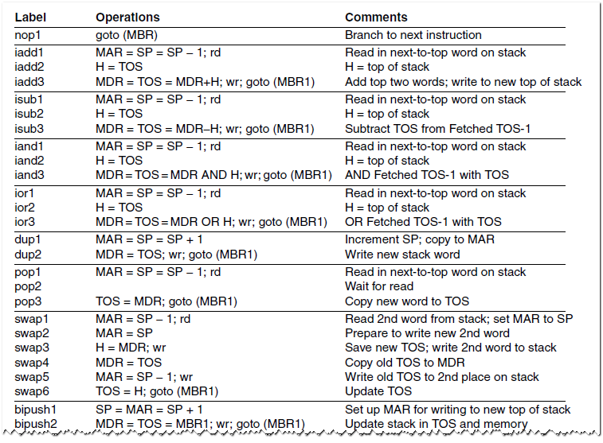
Pipelined Design: The Mic-3 (2)

Slide 48
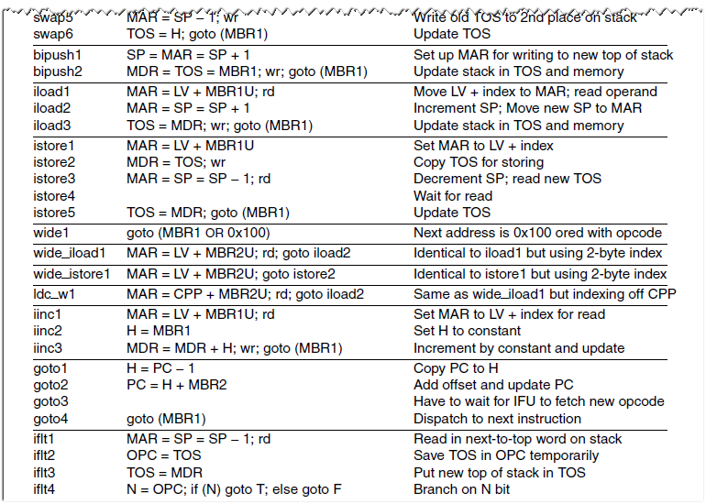
Pipelined Design: The Mic-3 (2)

Slide 49
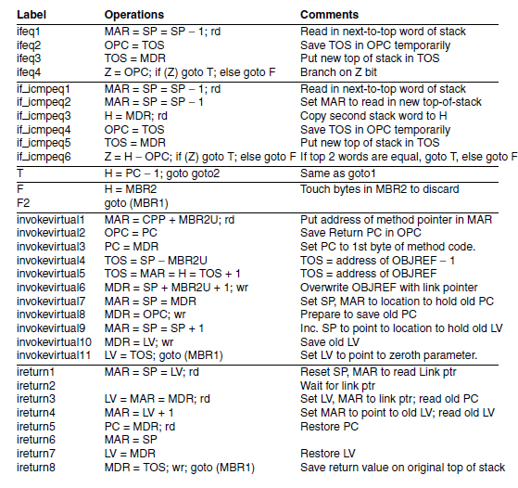
Pipelined Design: The Mic-3 (2)

Slide 50
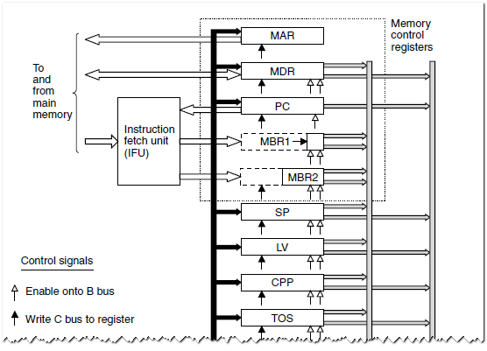
Pipelined Design: The Mic-3 (3)

Slide 51
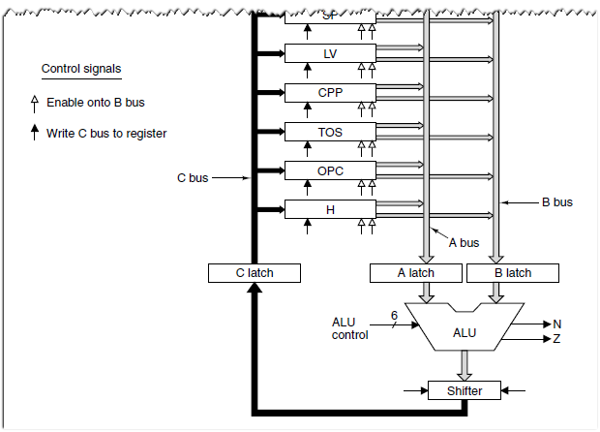
Pipelined Design: The Mic-3 (3)

Slide 52
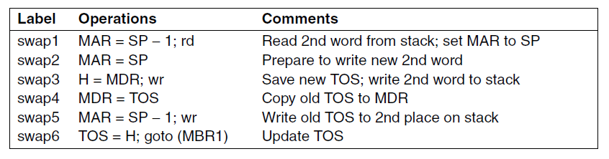
Pipelined Design: The Mic-3 (4)

Slide 53
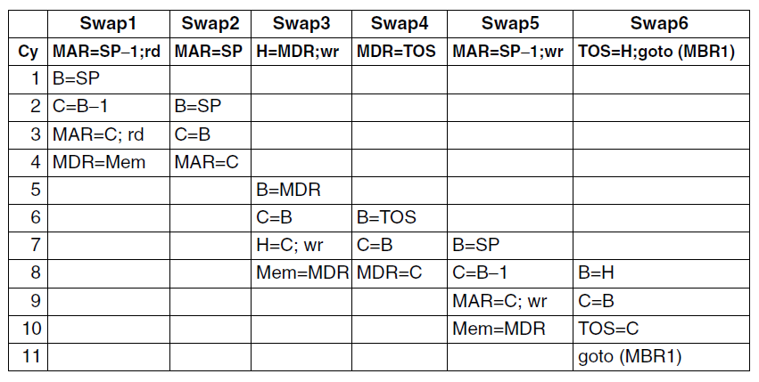
Pipelined Design: The Mic-3 (5)
Figure 4-33. The implementation of SWAP on the Mic-3.

Slide 54
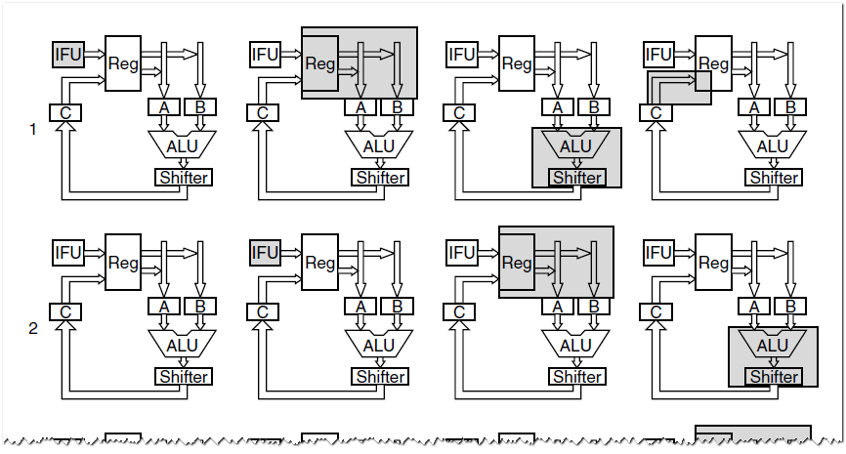
Pipelined Design: The Mic-3 (6)
Figure 4-34. Graphical illustration of how a pipeline works.

Slide 55
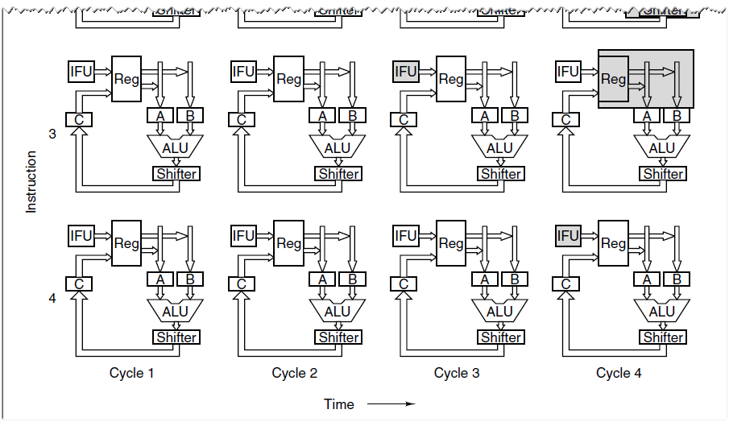
Pipelined Design: The Mic-3 (6)
Figure 4-34. Graphical illustration of how a pipeline works.

Slide 56
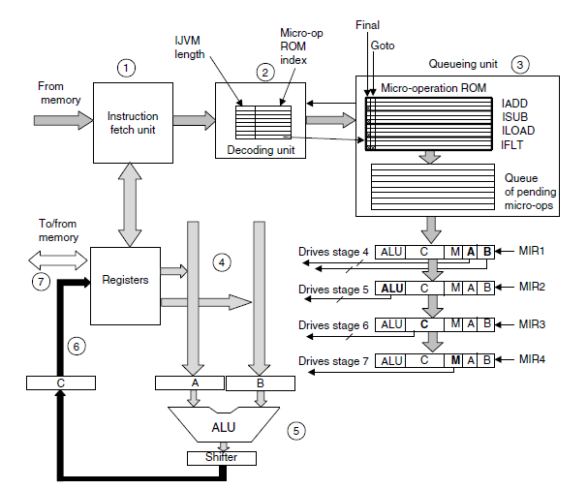
Seven-Stage Pipeline: The Mic-4 (1)

Slide 57
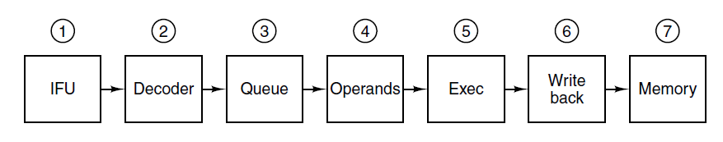
Seven-Stage Pipeline: The Mic-4 (2)

Slide 58

Cache Memory
Figure 4-37. A system with three levels of cache.

Slide 59
Direct-Mapped Caches (1)
Each cache entry consists of three parts:
Valid bit indicates whether there is any valid data in this entry
Tag with unique, 16-bit value identifying corresponding line of
memory from which data came
Data field contains copy of data in memory.
Holds one cache line of 32 bytes.

Slide 60

Direct-Mapped Caches (2)

Slide 61

Direct-Mapped Caches (3)
TAG field corresponds to Tag bits stored in cache entry.
LINE field indicates which cache entry holds corresponding data, if present.
WORD field tells which word within a line is referenced.
BYTE field usually not used, but if only single byte is requested, tells which byte within word is needed.

Slide 62

Set-Associative Caches

Slide 63

Branch Prediction

Slide 64

Dynamic Branch Prediction (1)

Slide 65

Dynamic Branch Prediction (2)
Figure 4-42. A 2-bit finite-state machine for branch prediction.

Slide 66

Out-of-Order Execution, Register Renaming (1)
Figure 4-43. A superscalar CPU with in-order
issue and in-order completion.

Slide 67

Out-of-Order Execution, Register Renaming (2)

Slide 68

Out-of-Order Execution, Register Renaming (3)
Figure 4-44. Operation of a superscalar CPU with out-of-order issue and out-of order completion.

Slide 69

Out-of-Order Execution, Register Renaming (4)
Figure 4-44. Operation of a superscalar CPU with out-of-order issue and out-of order completion.

Slide 70

Speculative Execution
Figure 4-45. (a) A program fragment.
(b) The corresponding basic block graph.

Slide 71

Core i7’s Sandy Bridge Microarchitecture

Slide 72

Core i7’s Sandy Bridge Pipeline (1)

Slide 73
Core i7’s Sandy Bridge Pipeline (2)
Scheduler queues send micro-ops into the 6 functional units:
ALU 1 and the floating-point multiply unit
ALU 2 and the floating-point add/subtract unit
ALU 3 and branch processing and floating-point compare unit
Store instructions
Load instructions 1
Load instructions 2

Slide 74

OMAP4430’s Cortex A9 Microarchitecture

Slide 75

OMAP4430’s Cortex A9 Pipeline (1)

Slide 76

OMAP4430’s Cortex A9 Pipeline (2)

Slide 77

Microarchitecture of the ATmega168 Microcontroller

Slide 78
End
CHAPTER 4

